Slide 1
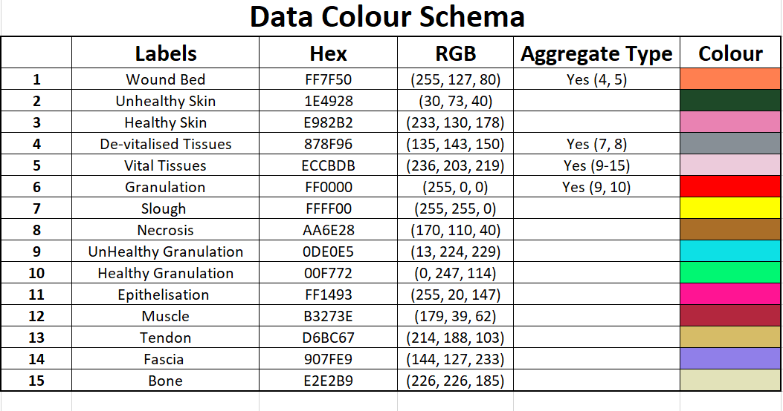

Slide 2
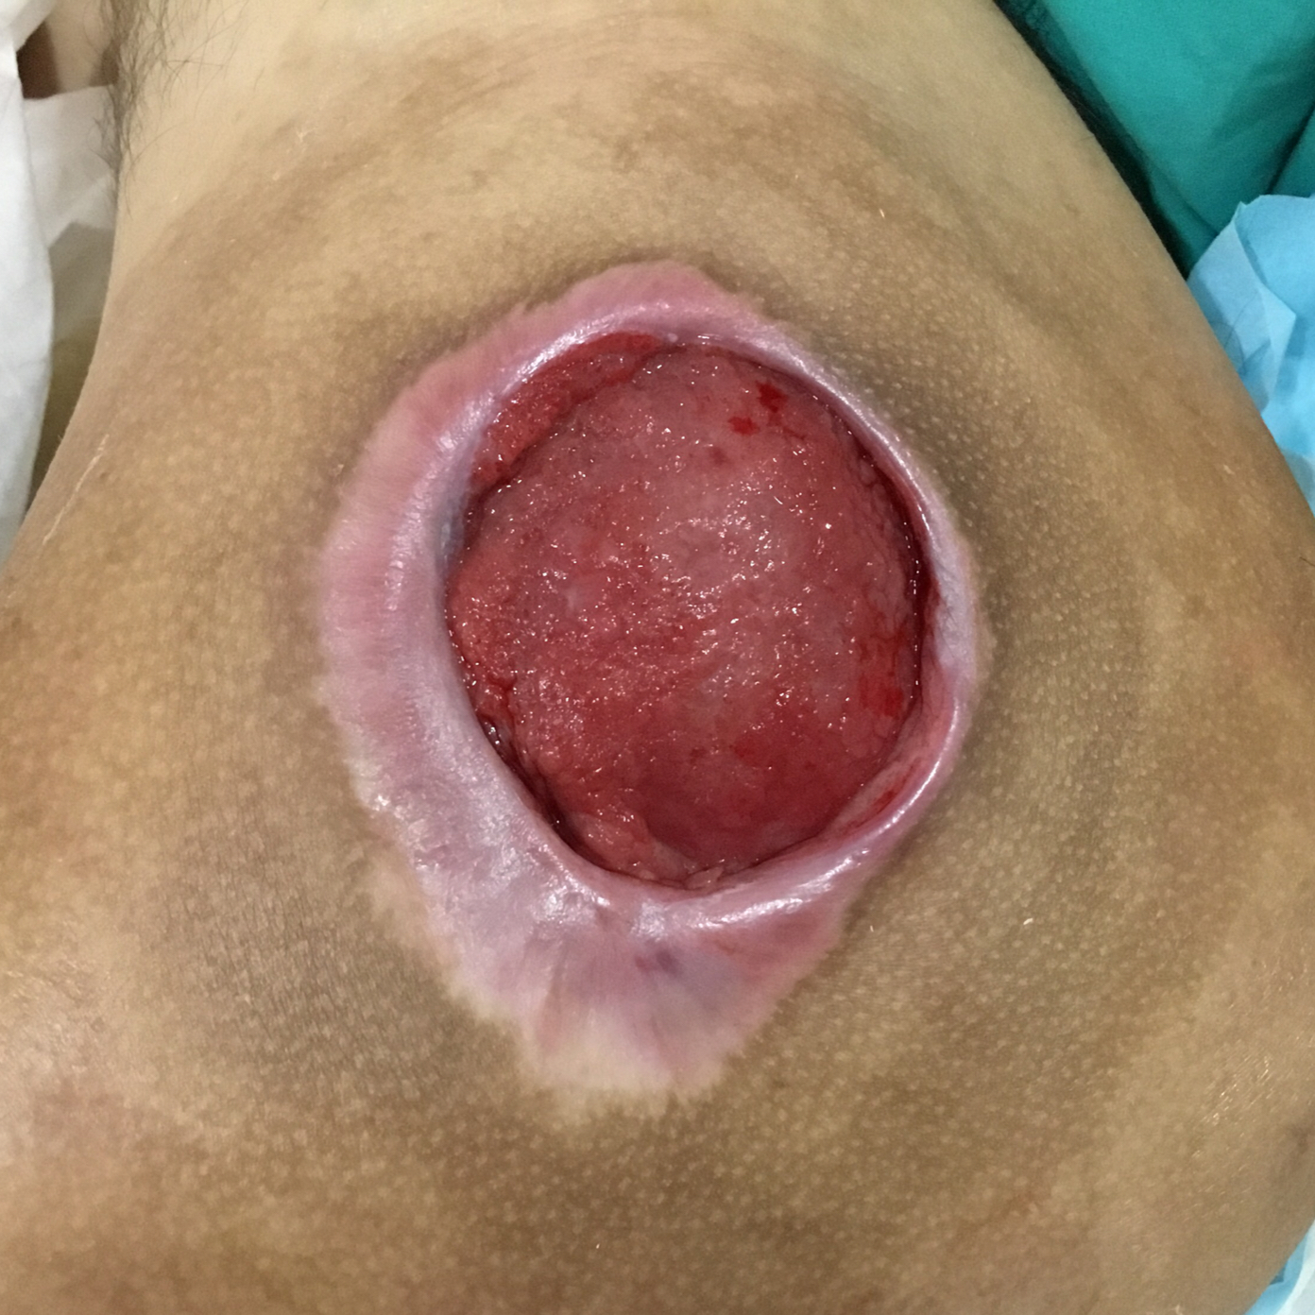
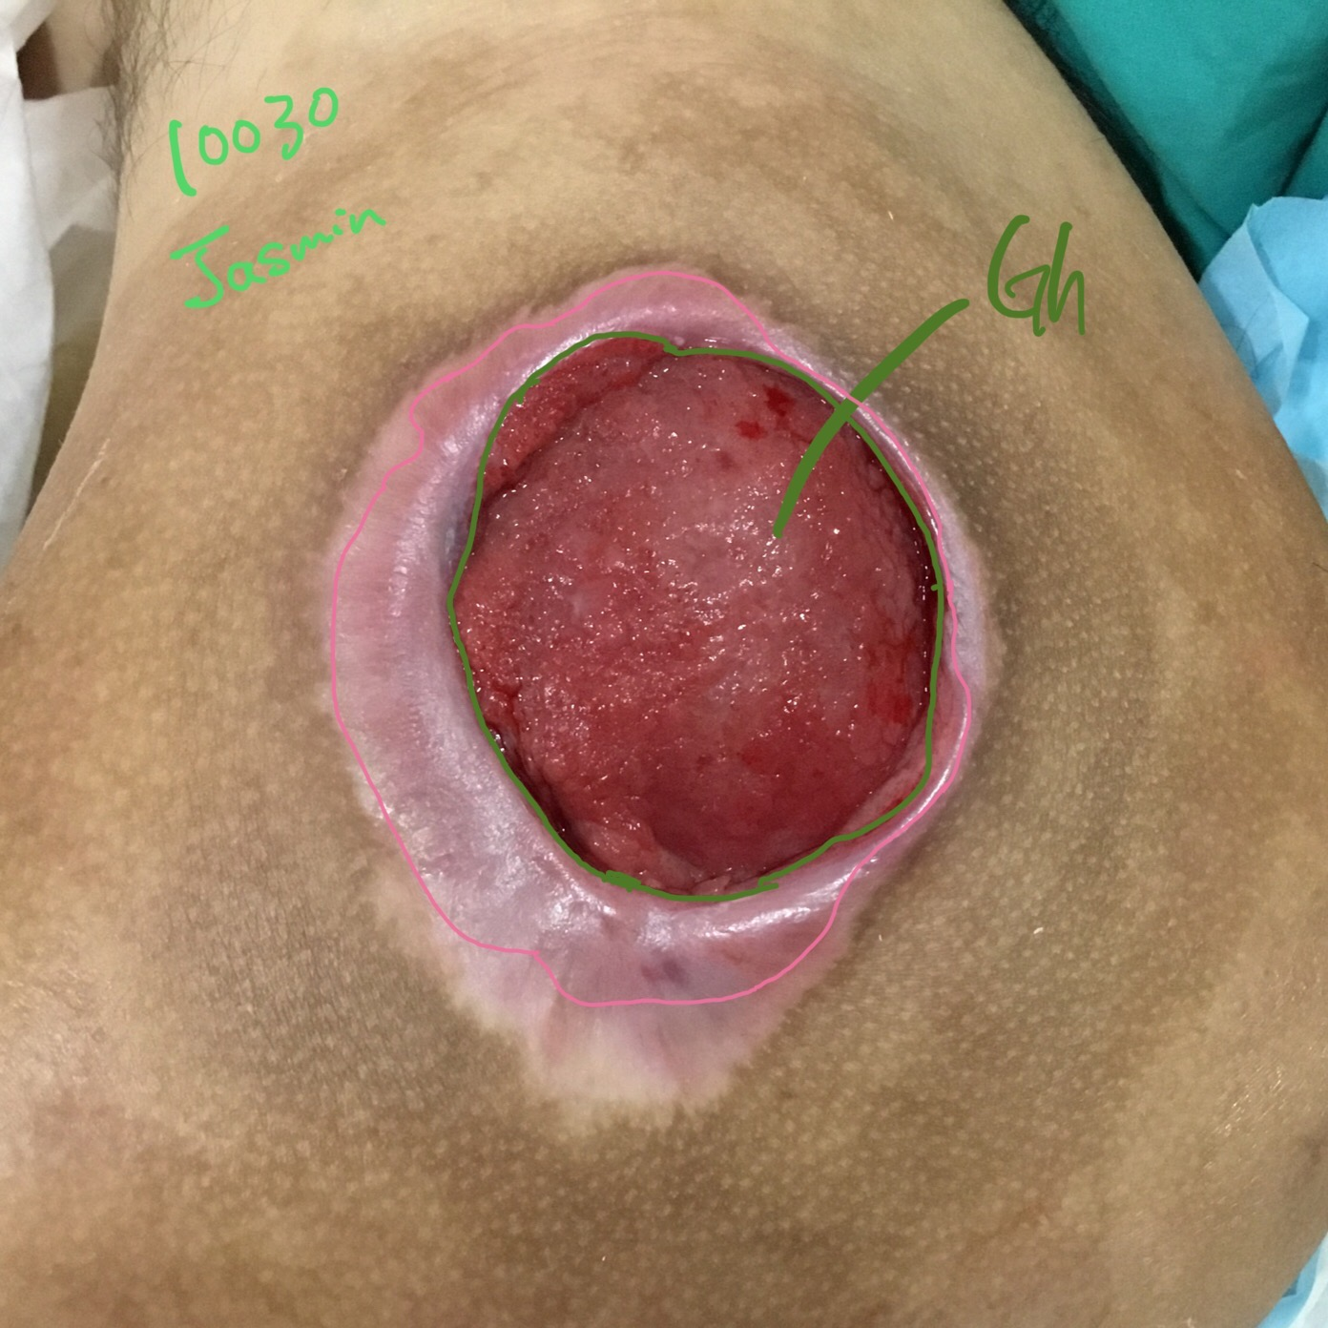

Original Wound Img
Latest Annotation
Original Mask
Metadata Wound Location: Wound Type:

Slide 3
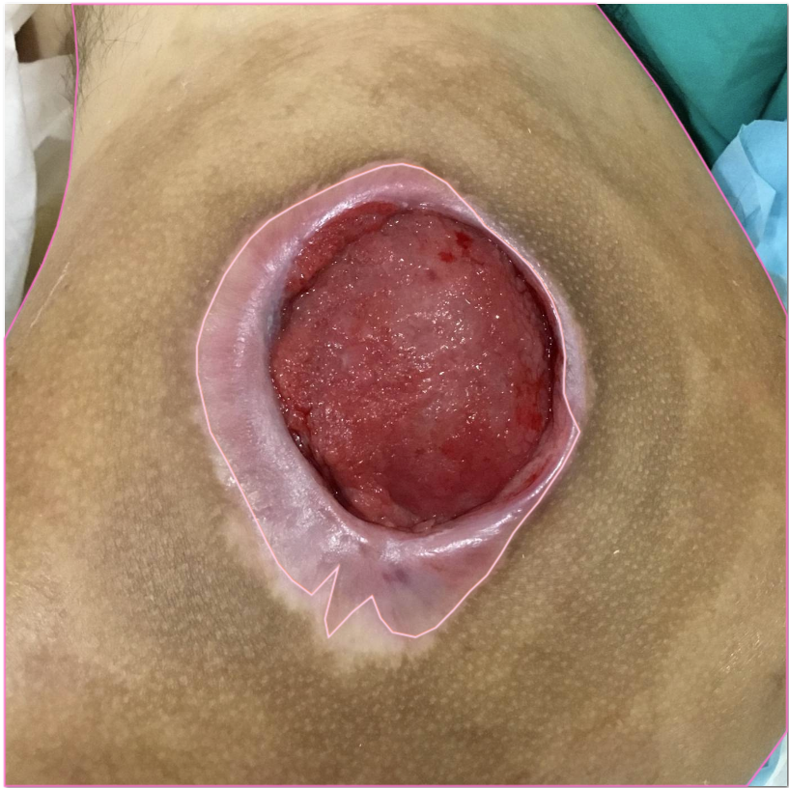
epithelizing/healthy skin?

Slide 4
Notes:
The two areas highlighted are epithelization - rest is skin. In perspective i would just label all as healthy skin. Just to show u the difference for the future and in comparison with the other images.

Slide 5

Original Wound Img
New Mask
Original Mask

Slide 6
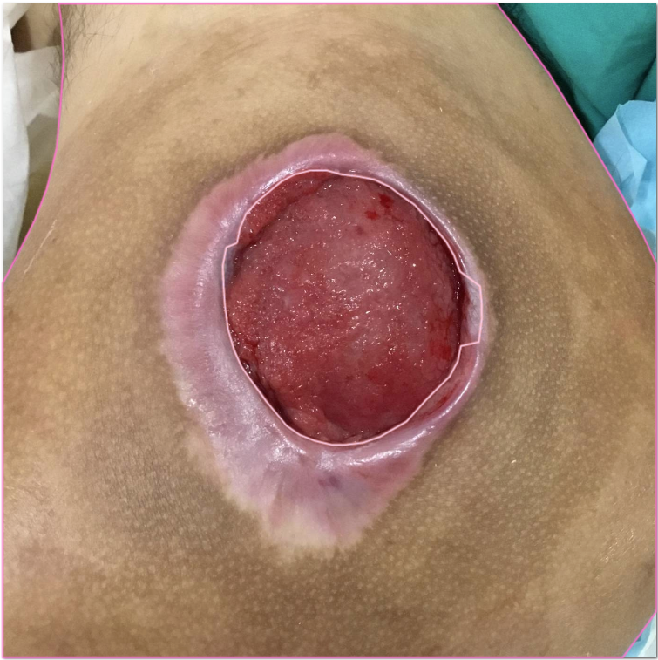

Slide 7

SD: Accepted

